Slide 1
fans and followers to customers:
success stories of social media
Joel Lumsden
@attacat_joel
www.attacat.co.uk
Notes:
Present your product for 1 minute
Everyone else then spends a couple of minutes coming up with possible keywords for ther buiness – how you would search, how other poeple may search
White all up on the white board
Looking for the big split of keywords that people may use
Good idea to bring in a few people for a 10 minute brainstorming session to get ideas of how peolpe may search then use the KW tool to check search volujes

Slide 2
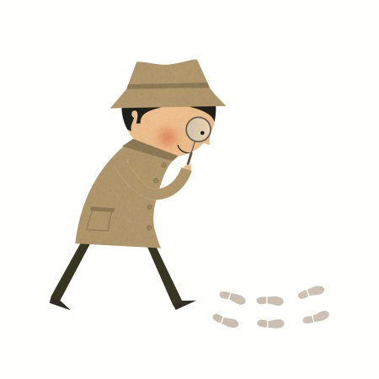
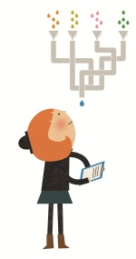
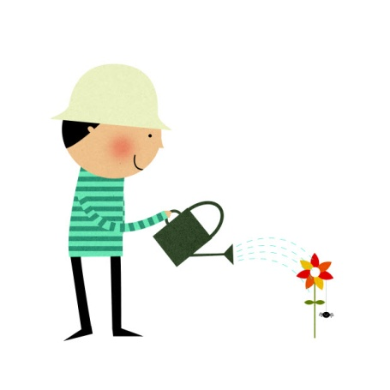
search advertising
seo
social media
content
tracking
Notes:
Misconception that social media can work on its own
Part of the online marketing mix

Slide 3
online marketing
Basically ‘being found online’
Different methods > similar aim
search advertising
seo
social media
online PR
Content and tracking
embrace
your service

Slide 4
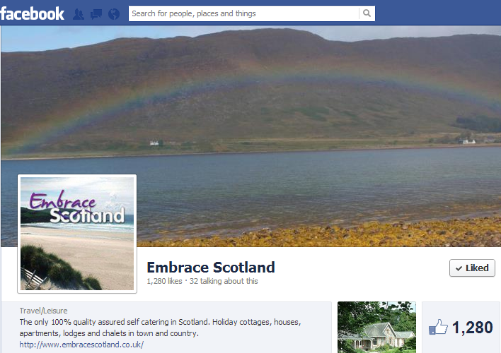
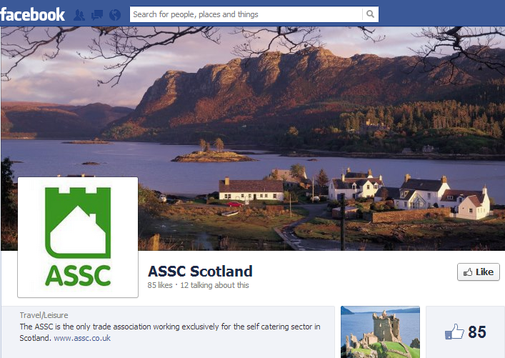
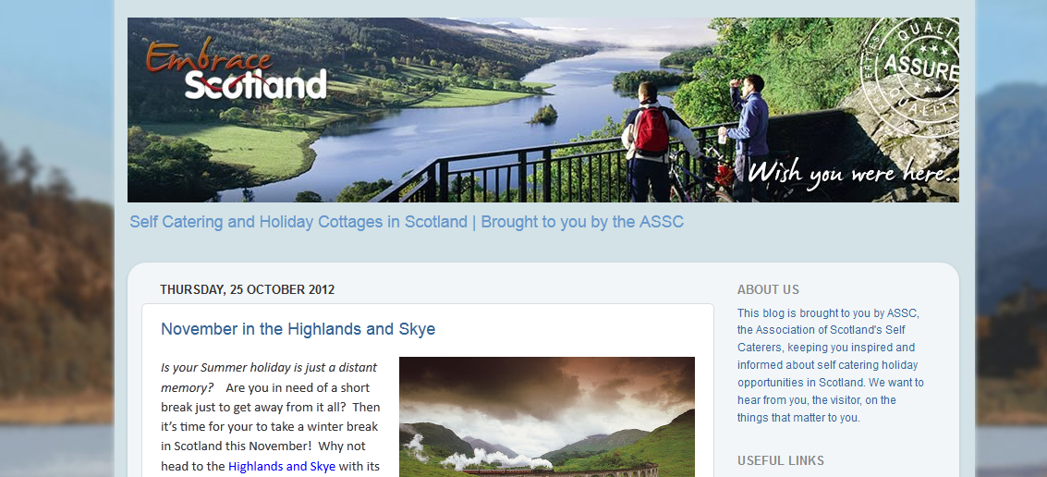
what the ASSC do
ASSC
Twitter and Facebook
Member emails
Embrace Scotland
Twitter and Facebook
7,406 followers, 1,280 likes
590 enquiries direct or assisted by social sources in 2012
But only 7% of total traffic
Newsletter
Blog

Slide 5
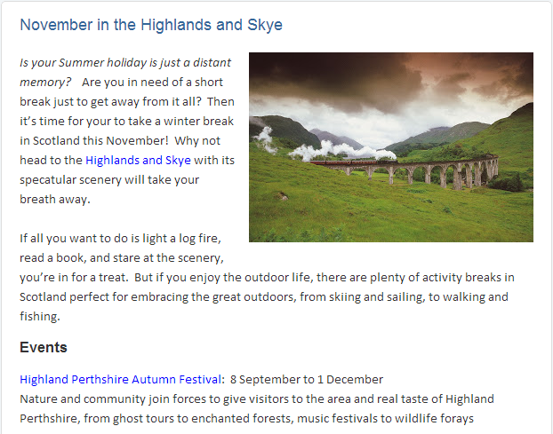
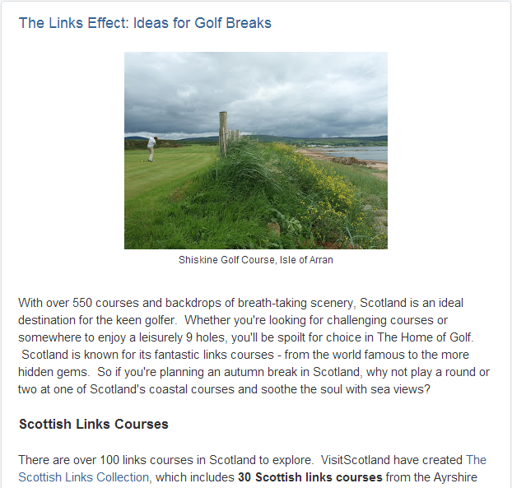
what the ASSC do
Blog
Different areas of Scotland
Different activities e.g. Fishing
Timely
Keyword focused

Slide 6
people not platforms
Don’t think about
Think about people and relationships
How can you connect to a relevant audience
Person-to-person relationships
Work with and find influencers:
Locals
Local businesses and organisations
Bloggers
Attractions
Travel associations

Slide 7
add value
Do something really interesting
Incredibly high quality
Something nobody else is doing
Social media is just a method of connecting people to value/content

Slide 8
creating content
What value can you contribute that nobody else can?
What do self caterers offer that others can’t?
Natural Scotland
Your local environment
Your local community
Use the natural assets!
?

Slide 9
contributing to embrace
The better EmbraceScotland performs, the more bookings you get.
So:
Link to www.embracescotland.co.uk from your homepage (text)
Contribute content:
Write about your area / secret spots
Write about events and local interest
Give them amazing photos/videos
If your content is good Embrace will promote!
Exposure in front of 1,280 Facebook, 7,406 Twitter, and XXX email subscribers
Probably the best, most accessible influencer you can find.

Slide 10
BUT
Do you actually need to do all that?

Slide 11
BUT
Social media is only worthwhile if it is returning value
For many the best return on time is targeting return customers

Slide 12
1 hour a week
Week 1
Go and connect with influencers and people in your area Locals, businesses and organisations, bloggers, attractions, travel associations. Followerwonk.com, Topsy.com.
Week 2
Incentivise guests to contribute feedback and use to promote social presences.
Week 3
Look at what influencers are sharing – start sharing their stuff and use to inform your content
Week 4
Brainstorm some unique ideas and useful content.
At the very least write something about your area and submit it for use on the Embrace blog.

Slide 13
happy socialising!
Build relationships
Be exceptional
Club together and use Embrace
Retain
Joel Lumsden
@attacat_joel
www.attacat.co.uk

